Slide 1

CAPSTONE Final Review Report
DIABETIC RETINOPATHY DETECTION AND CLASSIFICATION
Team
Mentor(s): Dr. Arnab Pattanayak
Students Name and Roll Number
Charvi Sofat 102115001
Pratinav Batra 102115004
Varun Kashyap 102115012
Paras Sharma 102115015
Vaibhav Kalra 102115104
Team no:27

Slide 2
Introduction
Project Overview:
The machine learning will use CNN to categorize the uploaded image.
Each image after processing after processing will be categorize into any one of the different level of stages.
The CNN model will be trained on a dataset of pre processed images of the fundus.
The final project would combine the machine learning model of CNN, written in python 3.
Need Analysis and Scope:
Prevalence of DR : DR is one of the leading causes of blindness in the world. Among individuals with diabeties, the prevalence of DR is approximately 20.5% in the US and 18% in India.
Imperative Nature : Patients with mild and moderate/ severe retinopathy had 81% and 314% increased risks of all-cause mortality, respectively . It’s absolutely imperative, therefore, to diagnose the disease in its early stages to mitigate the damage as much as possible, and this project aims to do just that.
Time Consuming : Traditionally, the classification of DR involves weighting numerous features and then locating such features. This is highly time-consuming for clinicians. Retinal photograph with medical interpretation is a widely accepted screening tool for DR. Computers can obtain quicker classifications once trained
Early Detection : Automated grading of DR has potential benefits such as increasing efficiency, reproducibility, reducing barriers to access, and improving patient outcomes by providing early detection and treatment. Thus, to maximize the clinical utility of automated grading, an algorithm to detect referable DR is required
Objectives:
To execute an automated detection of DR utilizing advanced fundus pictures. Early discovery of DR empowers medicine or laser treatment to be performed to prevent or delay vision loss. We shall be achieving this by building a neural network model based on CNN that can automatically look at a patient’s retina image and estimate the severity of blindness in the patient.
The focus will be on finding the stage of DR in the patient eye with an accuracy good enough compared to a human doctor. And then finally deploy the model on the internet for the use of prediction and medical testing. This automated process can reduce a lot of time, thereby screening the process of treating DR at a large scale.

Slide 3
Literature Survey
Literature Analysis : Fundus Photography
Fundus photography is the usage of fundus camera to photograph the region of the eye.
Although the equipment for fundus photography can be easily accessible but a qualified ophthalmologist who can analyze the fundus images cannot.
The population of diabetic patients is enormous yet the total number of ophthalmologists is only 29 per 1 million persons.
Literature Analysis : Deep CNN
Computer-aided diagnosis of DR has been explored in the past to reduce the burden on ophthalmologists and mitigate diagnostic inconsistencies between manual readers.
Automated methods to detect MAs and reliably grade fundoscopic images of DR patients have been active areas of research in computer vision.
The first ANNs explored the ability to classify patches of normal retina without blood vessels, normal retinas with blood vessels, pathologic retinas with exudates, and pathologic retinas with MAs.
Literature Analysis : Traditional Automated Works
Traditional methods often deploy various feature extraction modules to first extract useful information from the fundus images
the extracted features are passed to classifiers such as the support vector machine, random forest classifier, etc.
Such handmade feature-based methods are time consuming and often yield false results.

Slide 4
Literature Survey
Research Gaps :
The exact identification of the DR stage is notoriously tricky and requires human interpretation of fundus images.
CNN have been successfully applied in many adjacent subjects, and for diagnosis of DR itself which involve CNN architectures with transfer learning – ResNet50, InceptionNetV3, DenseNets etc.
The high cost of big labelled datasets, as well as inconsistency between different doctors, impede the performance of these methods.
Research Findings for Existing Literature :
Generalization Across Diverse Populations: While studies like Gulshan et al. (2016) show promise, challenges remain in generalizing these models across diverse populations and varying image qualities often seen in real-world settings.
Class Imbalance and Misclassification in Severity Levels: Kaggle’s Diabetic Retinopathy Detection Challenge highlighted how class imbalance affects deep learning models. Misclassifications between adjacent severity levels still pose a challenge, impacting clinical reliability.
Optimization of Multi-Stage Approaches for Interpretability: Multi-stage methods, such as those by Antal and Hajdu (2014), improve classification accuracy, but achieving interpretability while maintaining robustness in detection remains challenging.

Slide 5
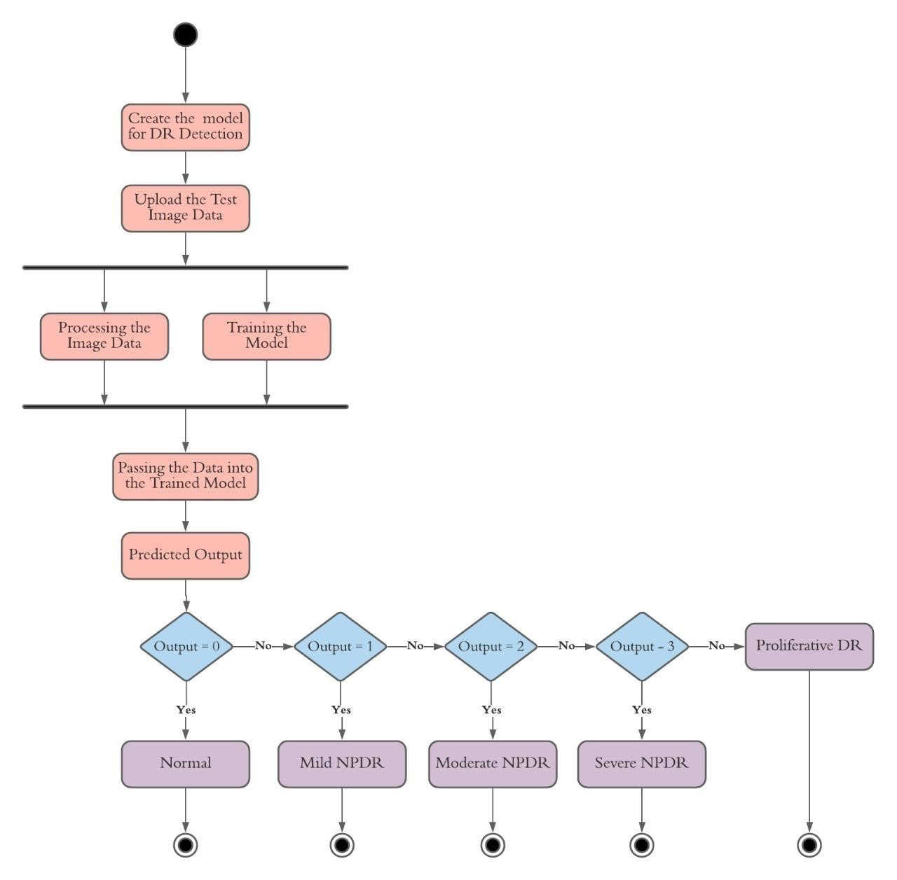
Proposed Approach
Concept Diagram :
( Clear detailed schematic / block diagram / flow chart depicting the proposed concept / solution )

Slide 6
Prospective Learning of the Project
Understanding the architecture and functioning of Convolutional Neural Networks (CNNs).
Learning to build, train, and fine-tune neural networks for image classification tasks.
Acquiring knowledge on pre-processing medical images, including techniques such as resizing, normalization, and augmentation
Learning to handle and interpret fundus images specifically used for diagnosing diabetic retinopathy.
Skills in collecting, organizing, and managing large datasets of medical images.
Understanding the importance of labelled data and techniques for annotating medical images.
Understanding the importance of cross-validation and testing on unseen data to ensure model generalization.
Using tools for image processing such as OpenCV or PIL.
Learning to deploy machine learning models to production environments.
Experience with web deployment frameworks (e.g., Flask, Django) and cloud services (e.g., AWS, Azure, Google Cloud).
Understanding how to automate the process of image analysis and diagnosis to handle large-scale data efficiently.
Gaining insights into diabetic retinopathy, its stages, and the clinical importance of early detection.
Understanding how AI and machine learning can be integrated into healthcare for improved diagnostics.
Experience in working collaboratively in a multidisciplinary team, including data scientists, software engineers, and medical professionals.
Developing skills in documenting the project development process, findings, and results.

Slide 7
IEEE Standards to be used
IEEE 11073-10207-2017: IEEE Standard for Service-Oriented Medical Device Exchange Architecture & Protocol Binding
IEEE 42010-2011: IEEE Standard for Systems and Software Engineering
IEEE 1599-2008: IEEE Standard for Signal Processing and Analysis of Electroretinograms
IEEE 1073-2008: IEEE Standard for Health Informatics
IEEE 1855-2016: IEEE Standard for Learning Technology
IEEE 2432-2017: IEEE Standard for Verilog Register Transfer Level (RTL) Synthesis
UG Courses referred
Machine Learning
Software engineering
Python

Slide 8
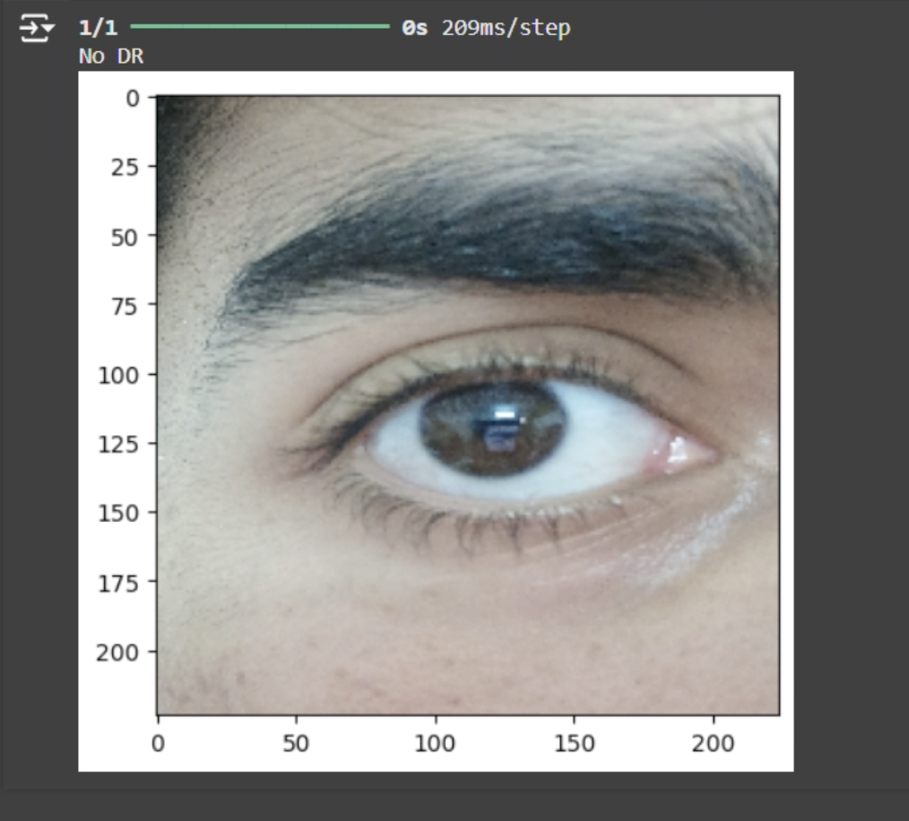
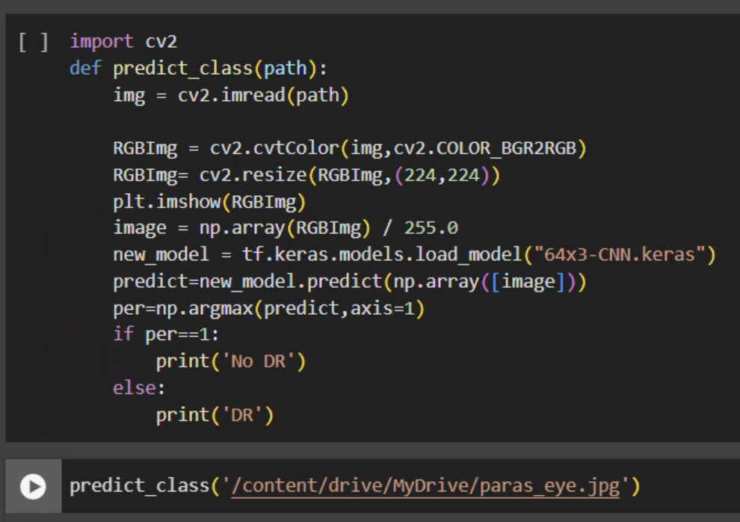
Outcomes of the Project
To diagnose the stage of DR for the user’s fundus images
Allow users to upload images and receive an automated diagnosis of DR severity.
User can view the results, etc.
CNN becomes better as it categorizes more images.
Hospitals are less congested.
Patients that absolutely require in-person attention of doctors don’t have to wait as long.
Users are able to get diagnosed from anywhere in almost no time and free of cost.

Slide 9
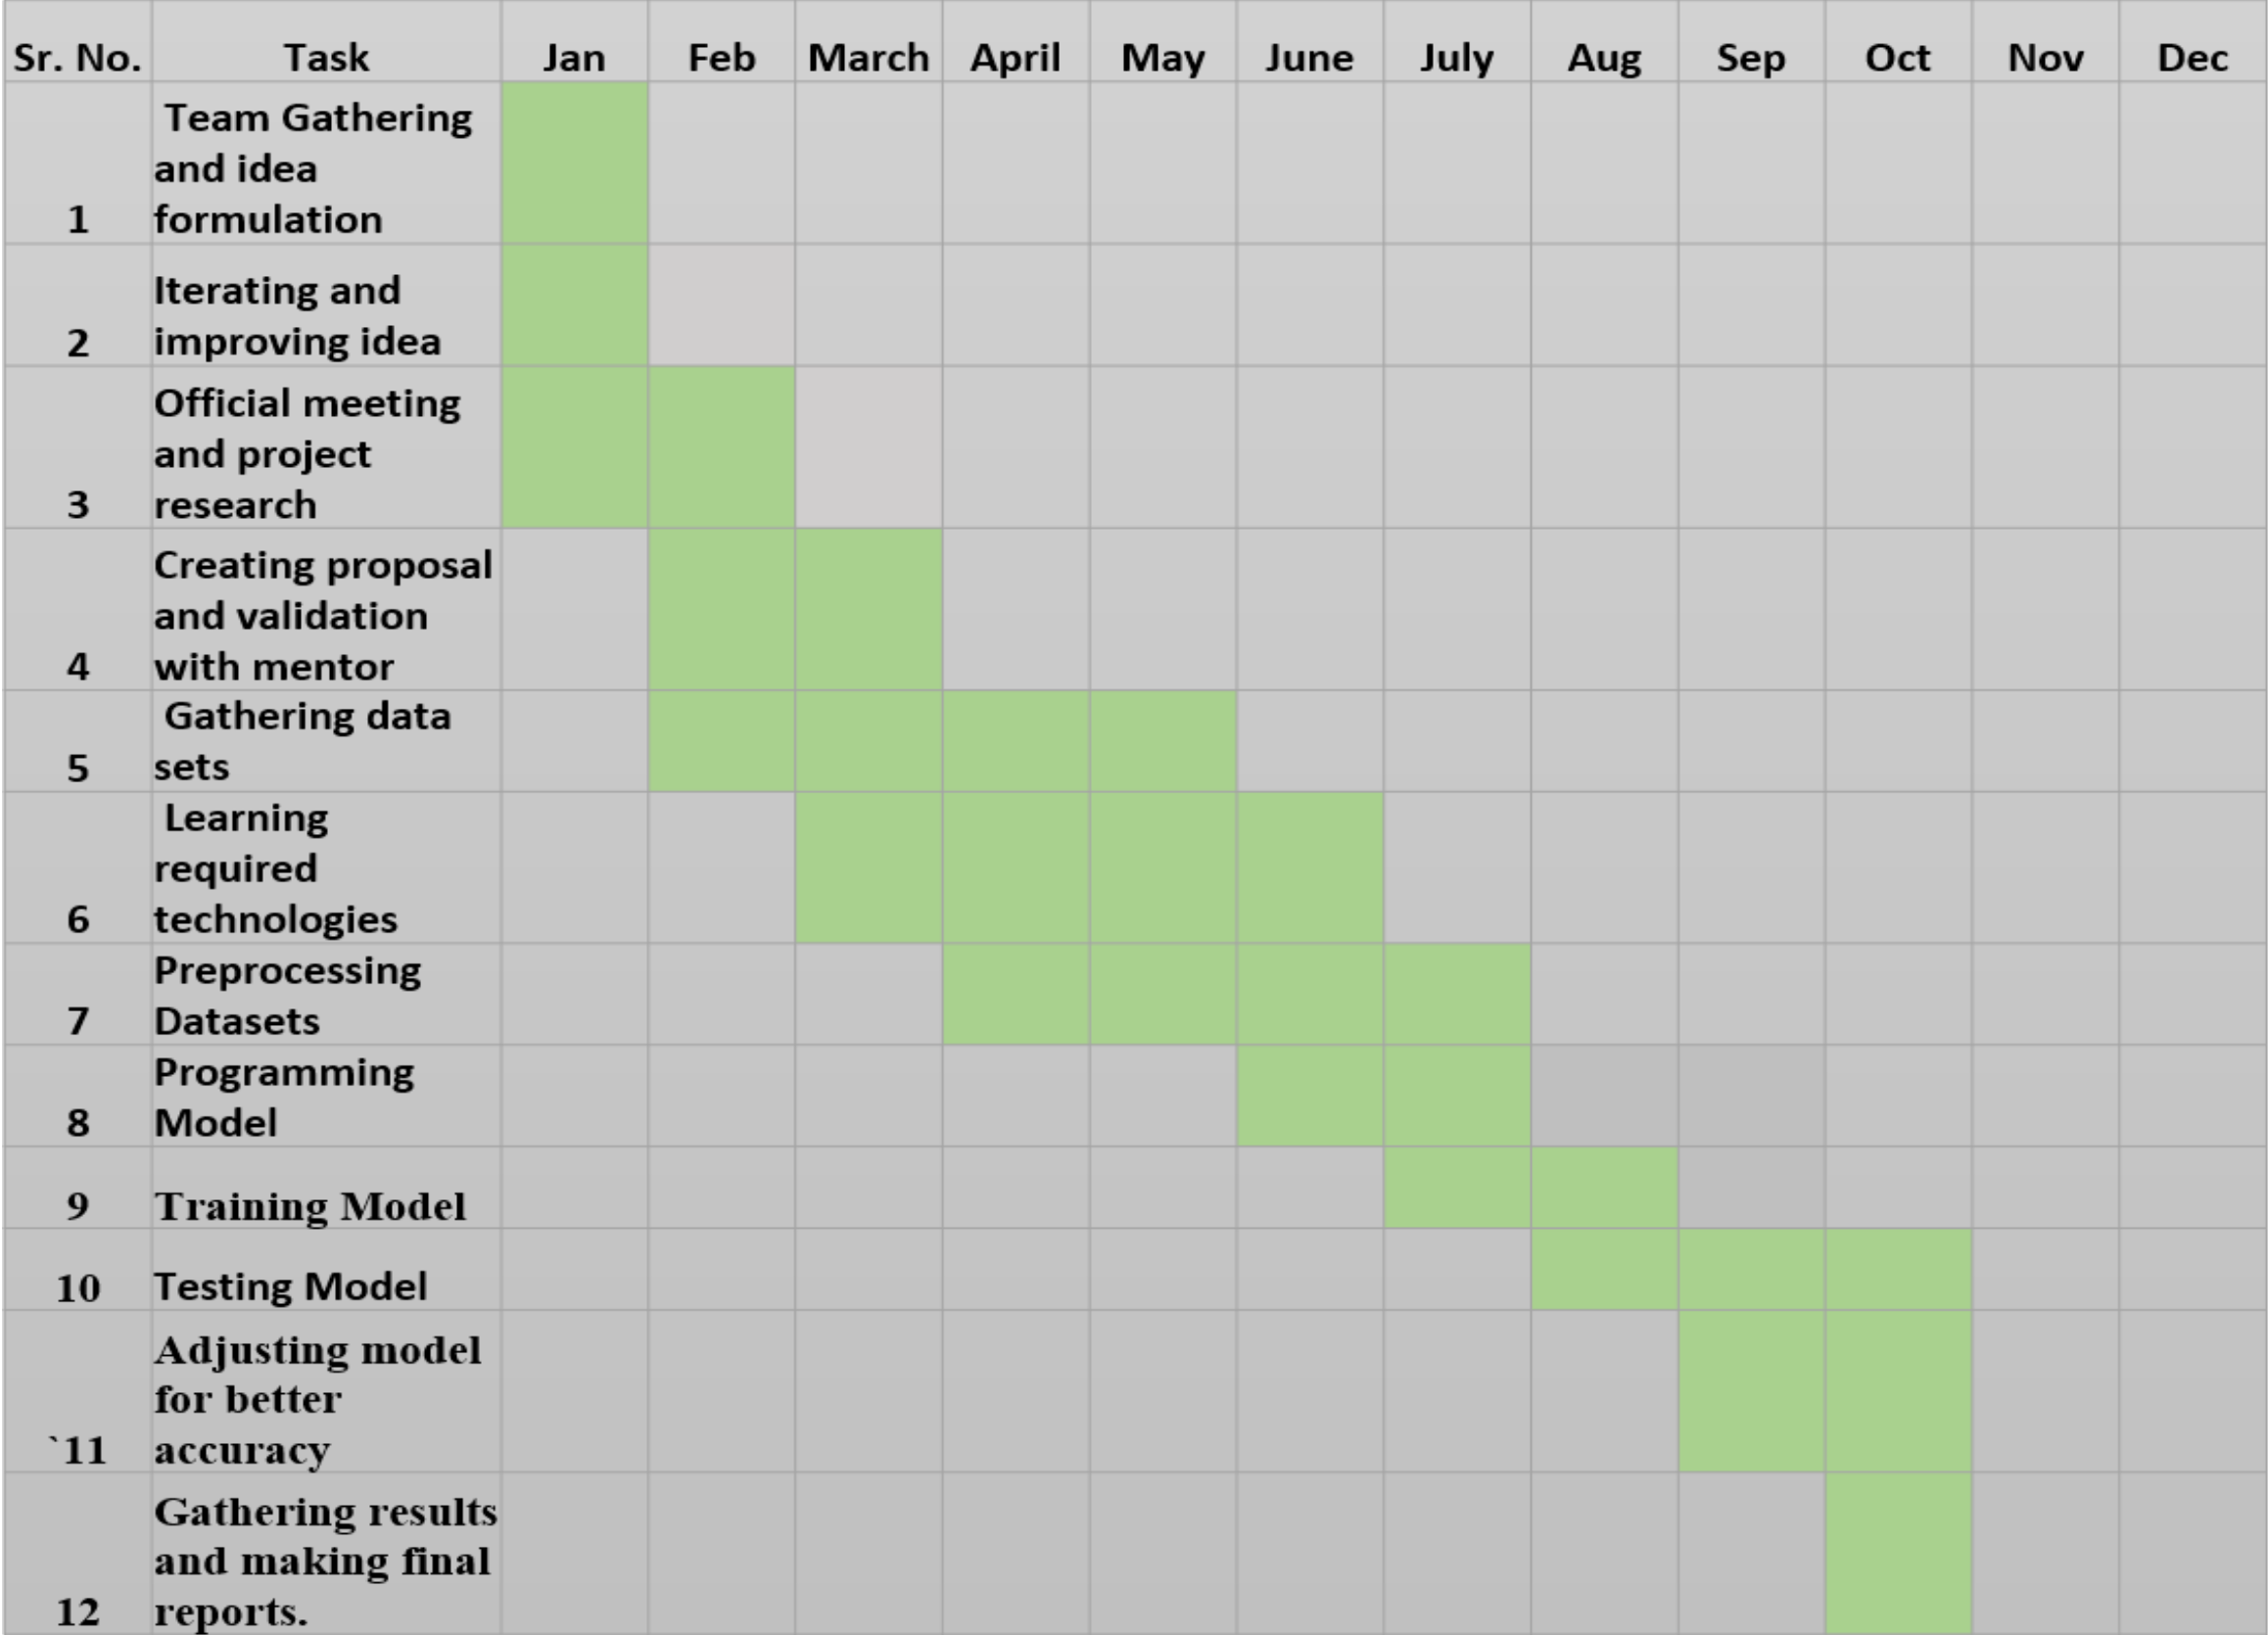
Project Timeline/Gantt Chart
Design the project timeline by filling the corresponding cell (strict to this format only)

Slide 10
Thank you

